Slide 1

Chapter 15 Part 3
Database Connectivity and Web Technologies
The slides in this presentation have been adapted from slides provided with the textbook, Database Systems: Design, Implementation, and Management,
12E, Cornel and Morris, Copyright © 2017 Cengage Learning.

Slide 2
Learning Objectives
What Extensible Markup Language (XML) is and why it is important for Web database development
About cloud computing and how it enables the database-as-a-service model
Copyright © 2017 Cengage Learning
2

Slide 3
Extensible Markup Language (XML)
Represents and manipulates data elements
Facilitates the exchange of structured documents over the Web
Characteristics
Allows definition of new tags
Case sensitive
Must be well-formed and properly nested
Comments indicated with <- and ->
XML and xml prefixes reserved for XML tags only
Copyright © 2017 Cengage Learning
3

Slide 4
Document Type Definitions (DTD)
File with .dtd extension that describes elements
Provides composition of database’s logical model
Defines the syntax rules or valid tags for each type of XML document
Companies engaging in e-commerce transaction must develop and share DTDs
DTD referenced from inside XML document
Copyright © 2017 Cengage Learning
4

Slide 5
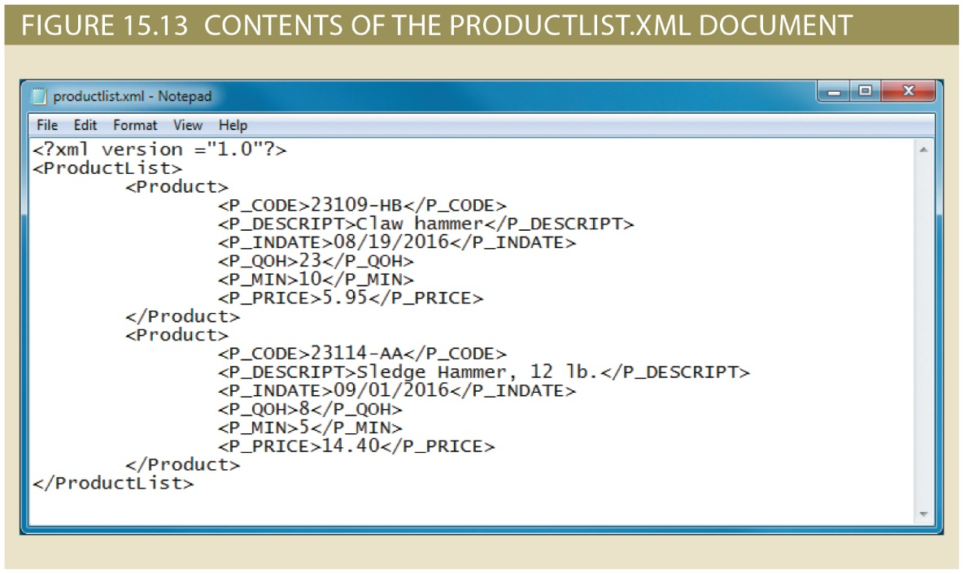
Copyright © 2017 Cengage Learning
5

Slide 6
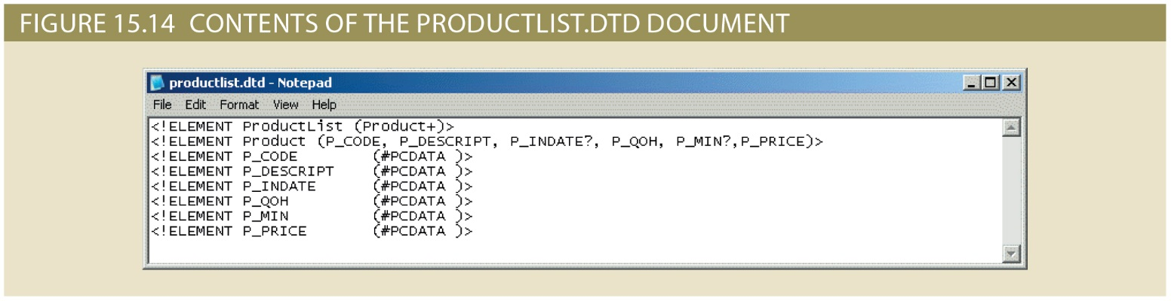
Document Type Definitions (DTD)
Copyright © 2017 Cengage Learning
6

Slide 7
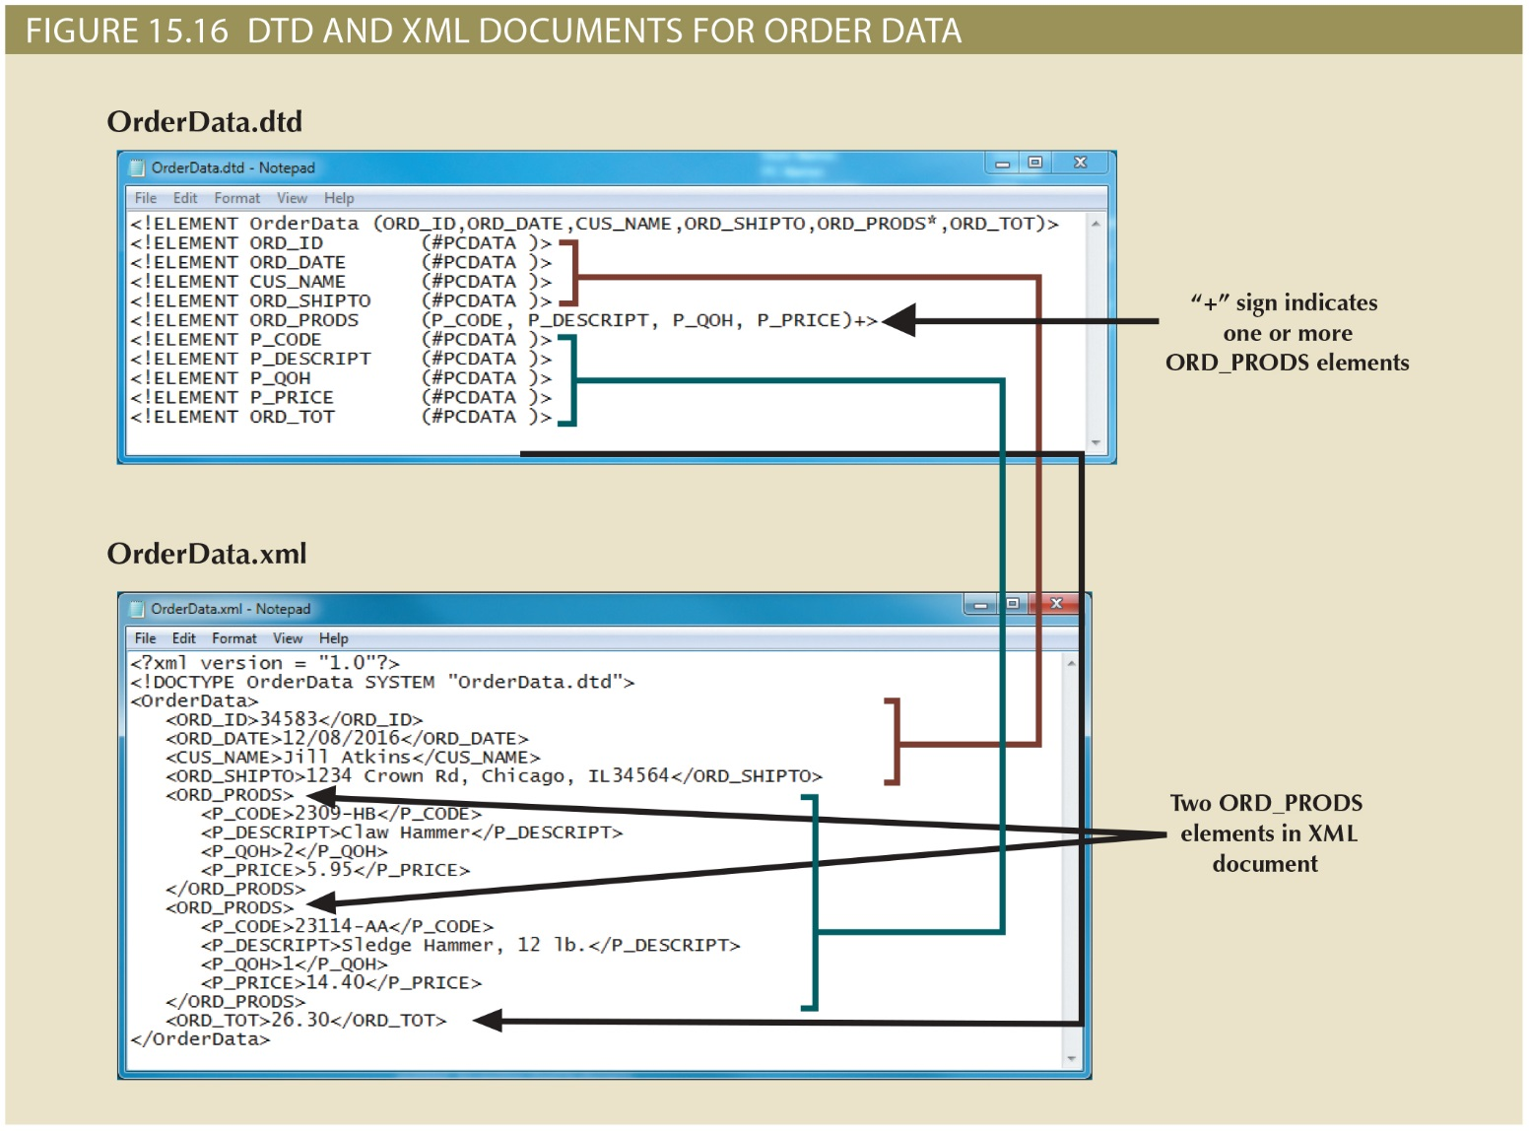
Copyright © 2017 Cengage Learning
7

Slide 8
Document Type Definitions (DTD) and XML Schemas (cont’d.)
XML schema
Advanced data definition language
Describes the structure of XML data documents
Advantage of XML schema:
More closely maps to database terminology and features
XML schema definition (XSD) file uses syntax similar to XML document
Copyright © 2017 Cengage Learning
8

Slide 9
XML Presentation
XML separates data structure from presentation and processing
Extensible Style Language (XSL) displays XML data
Defines the rules by which XML data are formatted and displayed
Parts:
Extensible Style Language Transformations (XSLT)
XSL style sheets
Copyright © 2017 Cengage Learning
9

Slide 10
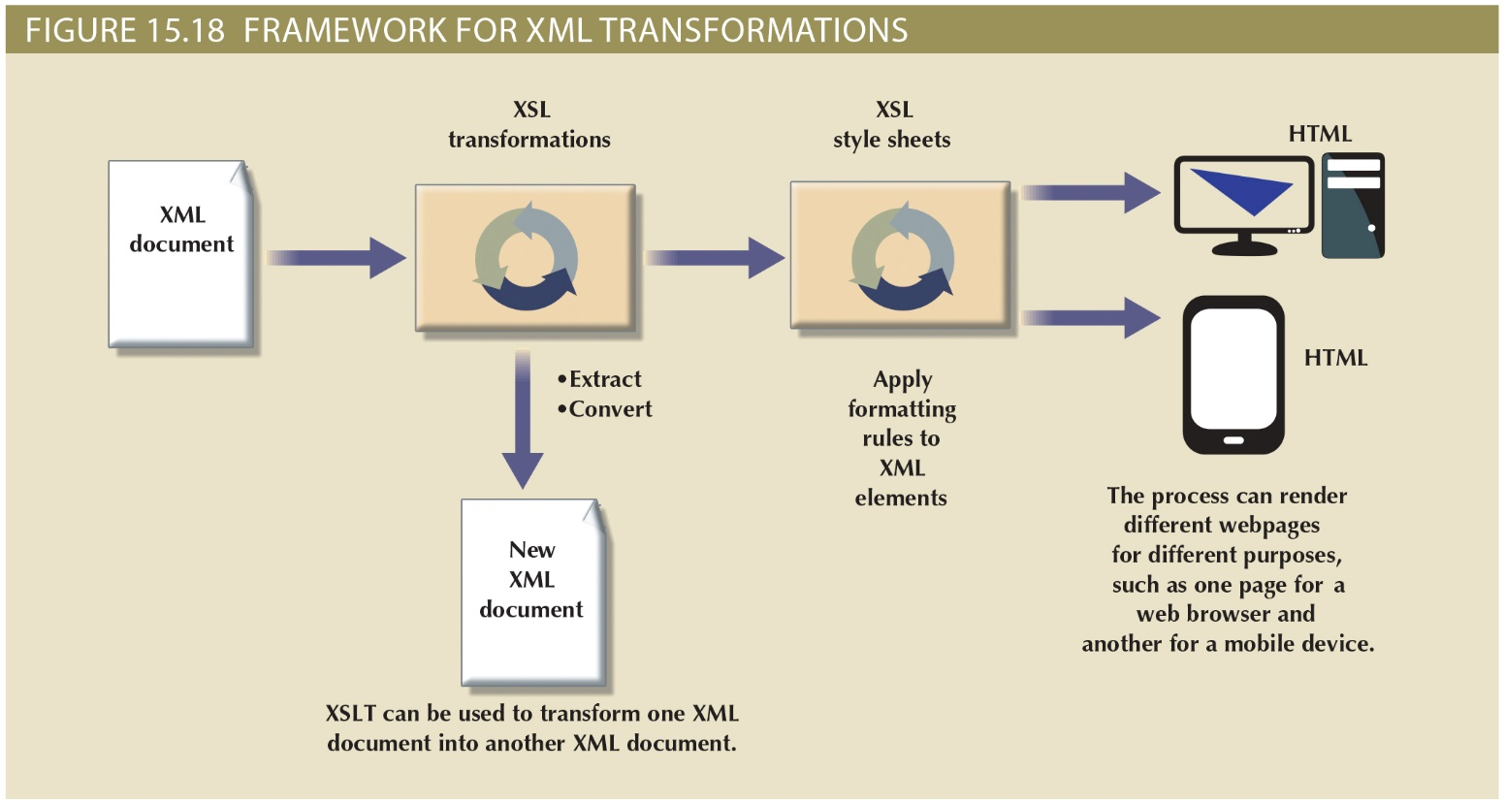
Copyright © 2017 Cengage Learning
10

Slide 11
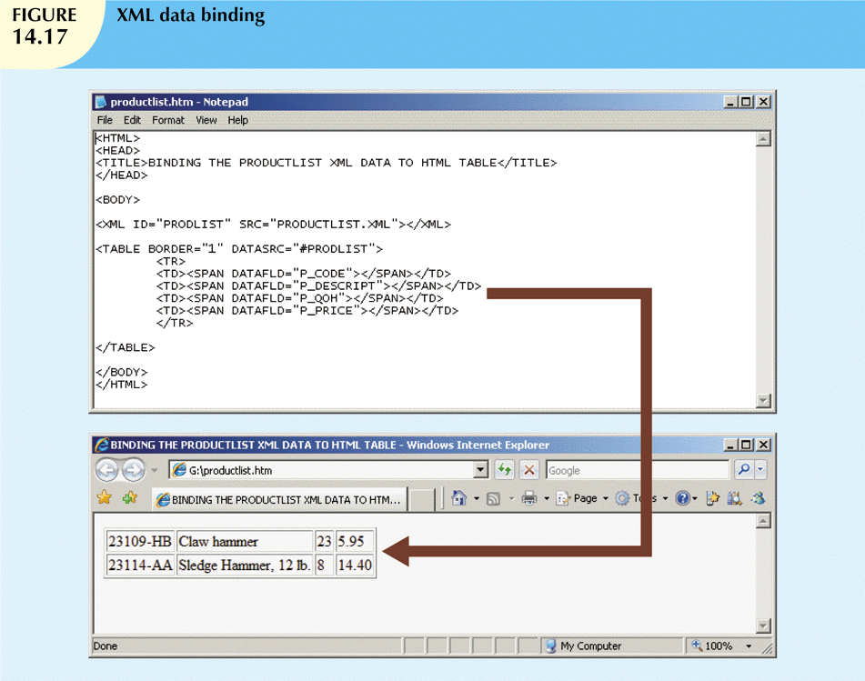
Copyright © 2017 Cengage Learning
11

Slide 12
XML Applications
B2B exchanges
Legacy systems integration
Web page development
Database support
Database meta-dictionaries
XML databases
XML services
Copyright © 2017 Cengage Learning
12

Slide 13
Cloud Computing Services
Computing model that enables access to a shared pool of configurable computer resources that can be:
Rapidly provisioned
Released with minimal management effort or service provider interaction
Potential to become a game changer
Eliminates financial and technological barriers
Copyright © 2017 Cengage Learning
13

Slide 14
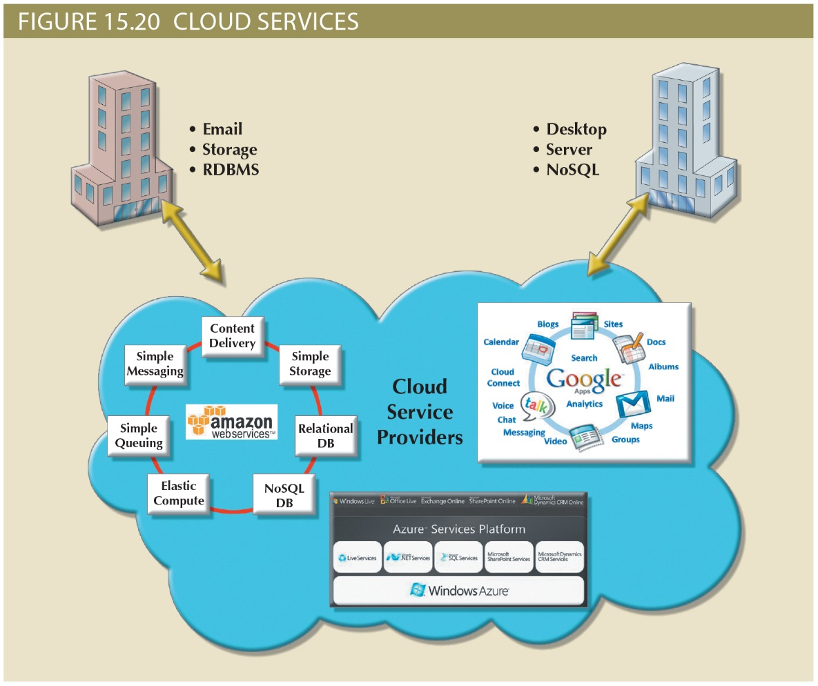
Figure 14.20 - Cloud services
Copyright © 2017 Cengage Learning
14

Slide 15
Cloud Implementation Types
Public cloud
Private cloud
Community cloud
Built by a third-party organization to sell cloud services to the general public
Built by an organization for the sole purpose of servicing its own needs
Built by and for a specific group of organizations that share a common trade
Copyright © 2017 Cengage Learning
15

Slide 16
Characteristics of Cloud Services
Ubiquitous access via Internet technologies
Shared infrastructure
Lower costs and variable pricing
Flexible and scalable services
Dynamic provisioning
Service orientation
Managed operations
Copyright © 2017 Cengage Learning
16

Slide 17
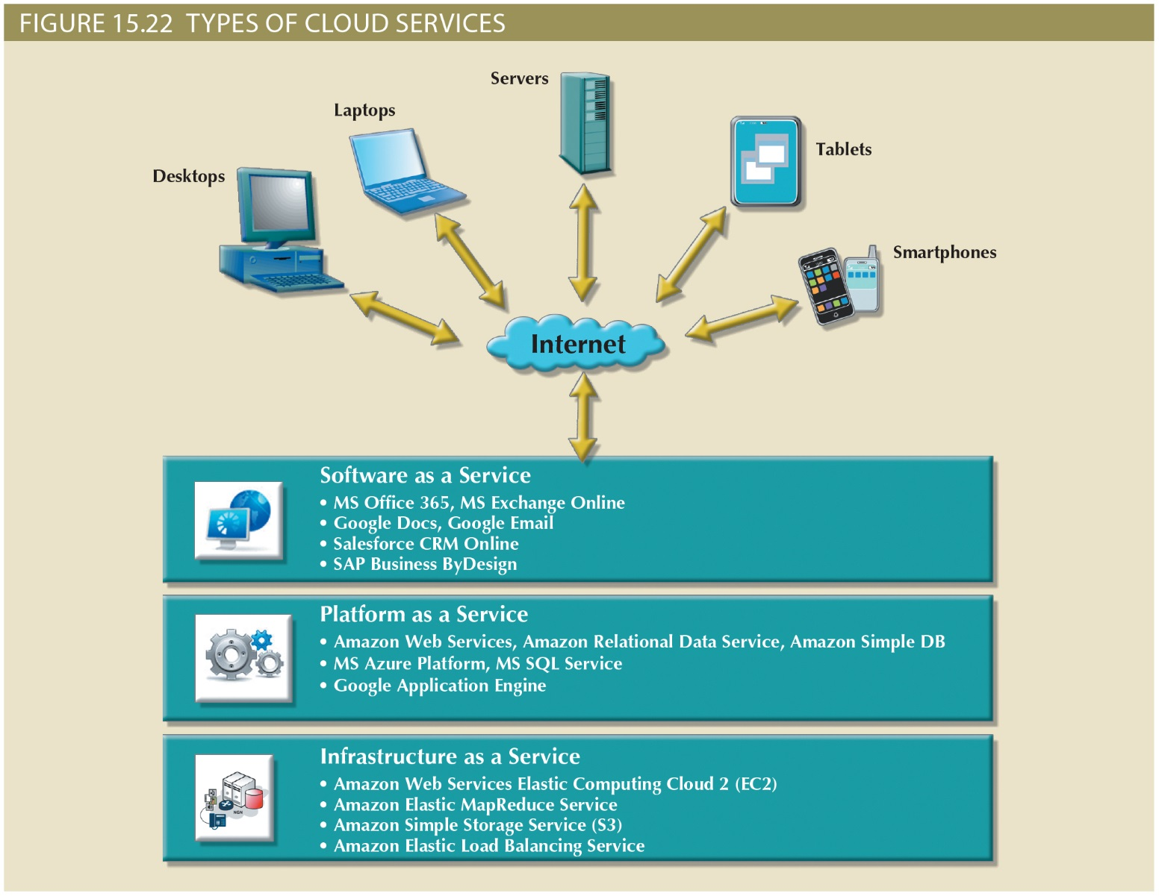
Copyright © 2017 Cengage Learning
17

Slide 18
Advantages and Disadvantages of Cloud Computing
Advantages
Disadvantages
Low initial cost of entry
Scalability/ Elasticity
Support for mobile computing
Ubiquitous access
High reliability and performance
Fast provisioning
Managed infrastructure
Issues of security, privacy and compliance
Hidden costs of implementation and operation
Data migration
Complex licensing schemes
Loss of ownership and control
Organization culture
Difficult integration with IT system
Copyright © 2017 Cengage Learning
18

Slide 19
Summary
XML provides semantics to share structured documents across the Web
Produces description and representation of data
Cloud Services provide almost all capabilities needed
Copyright © 2017 Cengage Learning
19

Slide 20
Task
Imagine what an .XML file that contains the grades for this class would like.
Copyright © 2017 Cengage Learning
20

